Slide 1

Data Structures
Chris Piech
CS106A, Stanford University

Slide 2
If I only had one
variable type…

Slide 3
It would be a HashMap

Slide 4
HashMap
key -> value
Can be any type

Slide 5
HashMap
A HashMap is a collection which allows you to look up values based on keys.

Slide 6
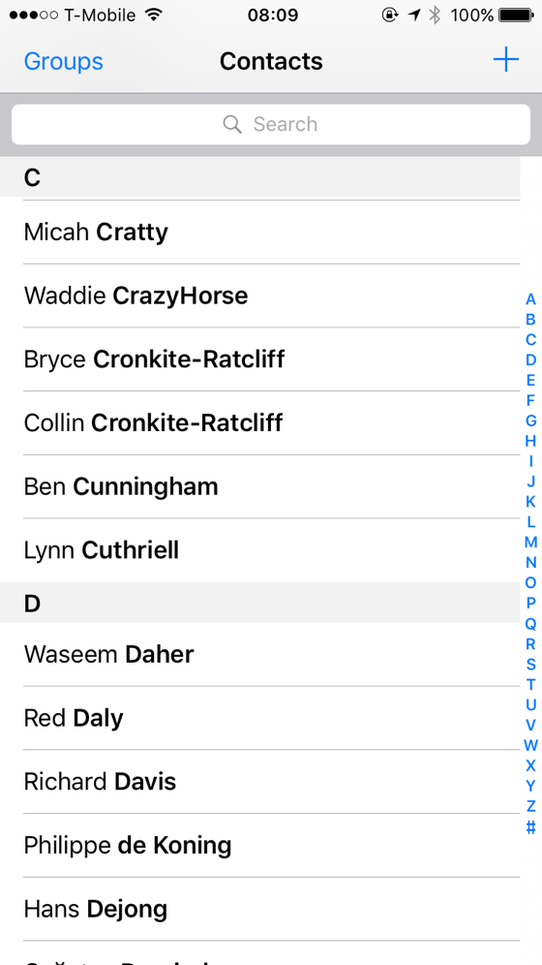
Name (String) -> Number (Integer)
6701678

Slide 7
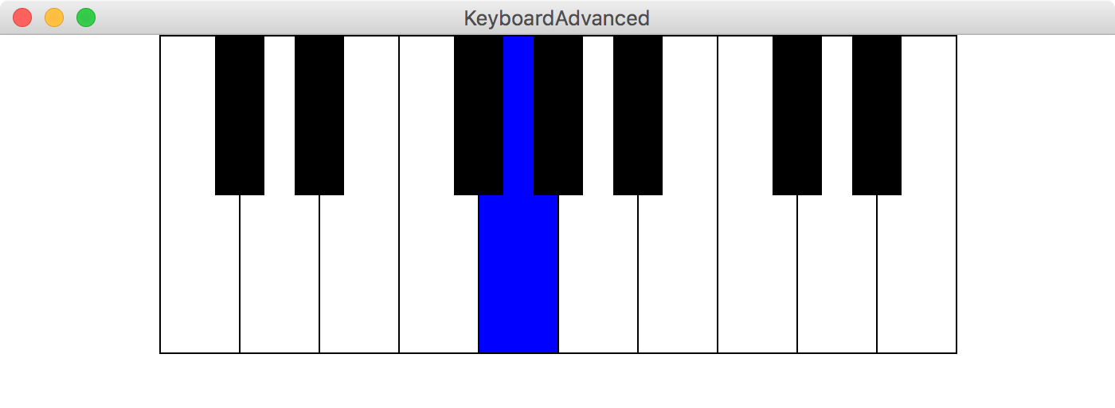
Keys (Grect) -> Sound (AudioFile)

Slide 8
Collections in CS106A
Aka Data Structures
Arrays
ArrayLists
Matrices
HashMaps
Indexed list. Fixed size.
Indexed list. Changes size.
Indexed array of arrays. Fixed size.
Lookup Values by Keys. Changes size

Slide 9
Aside: All collections are Objects
Collection variables store addresses. Manage memory well.
int[][] myMatrix = new int[5][3]
12
17
0
0
0
myMatrix
12
19
17
19
0
0
0
25
25
0
0
0
32
32
0
0
0

Slide 10
End Review

Slide 11
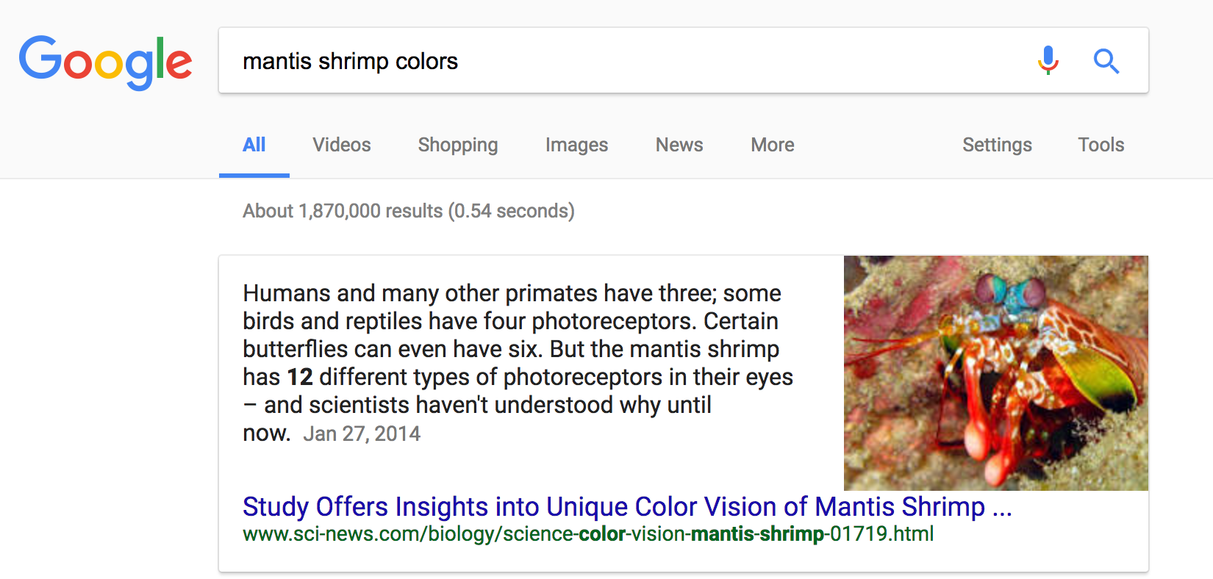
Why is this so fast?

Slide 12
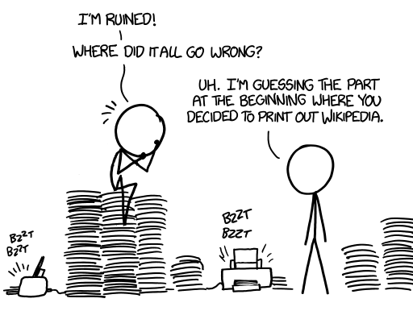
The internet is big
5 million articles and growing
Source: xkcd

Slide 13

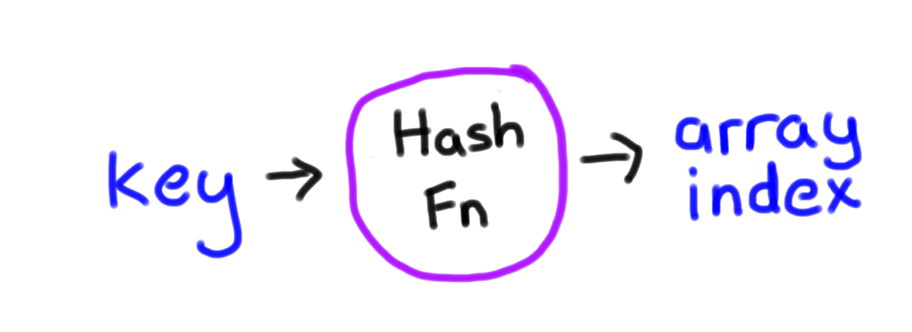
Why is this so fast?
Google search:
3
4
6
7
8
9
10
11
12
13
14
999,999,999
0
1
2
5
int hashFn(String key);
* Learn more in CS106B

Slide 14
A Basic Hash Function
int basicStringHash(String key) {
int preHash = 0;
for(int i = 0; i < key.length(); i++){
preHash += key.charAt(i);
}
return preHash % NUM_BUCKETS;
}
* Learn more in CS106B

Slide 15
Why is this so fast?
Any HashMap action is a two step process. Regardless of how much data is in the HashMap

Slide 16
HashMaps
for search

Slide 17
Google Search
Key
Value
All websites with that word
word
[
“Wikipedia.com/…”,
“Allrecipes.com/…”,
…
]
“Shrimp”

Slide 18
Single Key with
multiple Values?

Slide 19
Learn by Experimenting
6701678

Slide 20
Google Search
Key: search words
HashMap<String, ArrayList<String>>
Value: all websites with that word

Slide 22
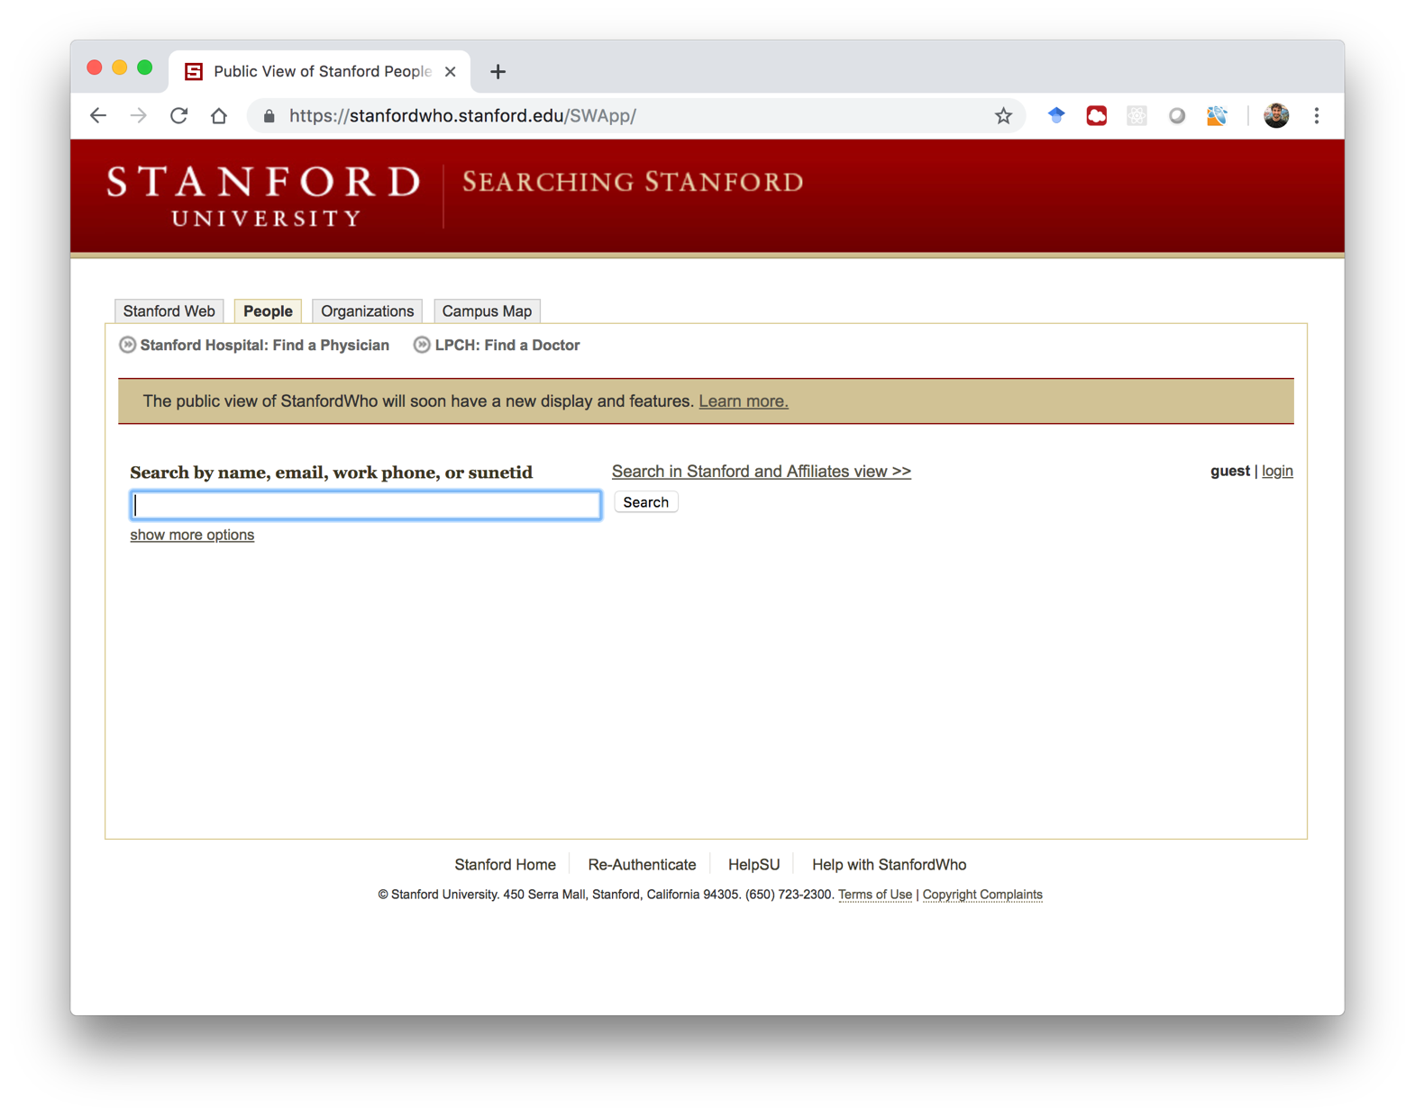

Slide 23
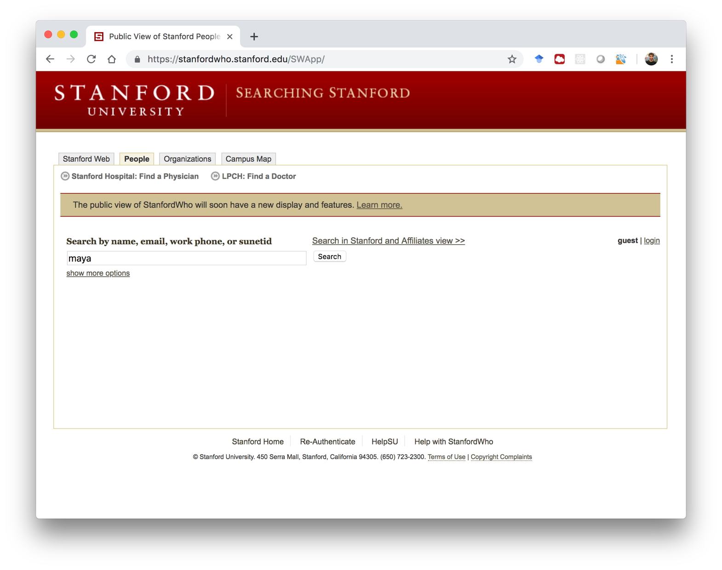

Slide 24
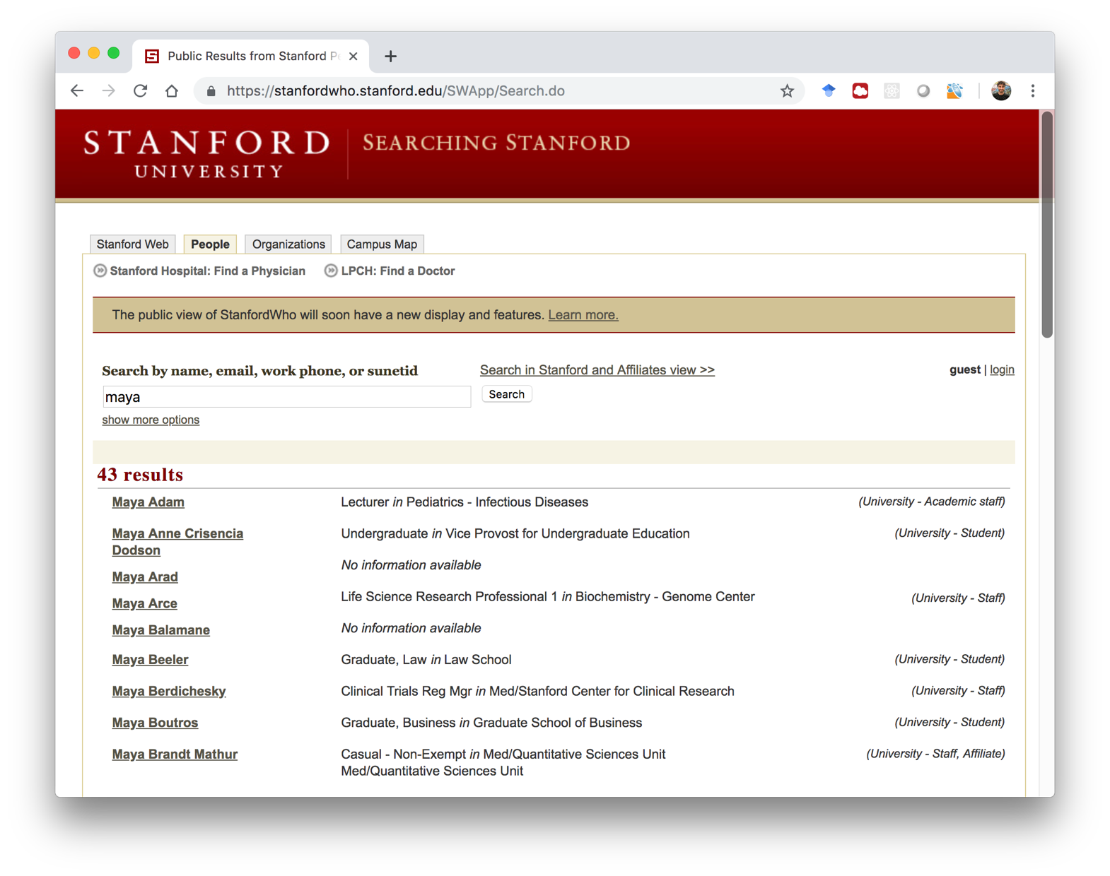

Slide 25
Section Leader Who
Laura
Cruz-Albrecht
(lcruz)
Chris Piech
(cpiech)
Brahm Capoor
(bcapoor)
Andrew Tierno
(atierno)
Christian Davis
(cdavis)
Maya Ziv
(mziv)
…

Slide 26
Section Leader Who
The user enters a query
You give the results

Slide 27
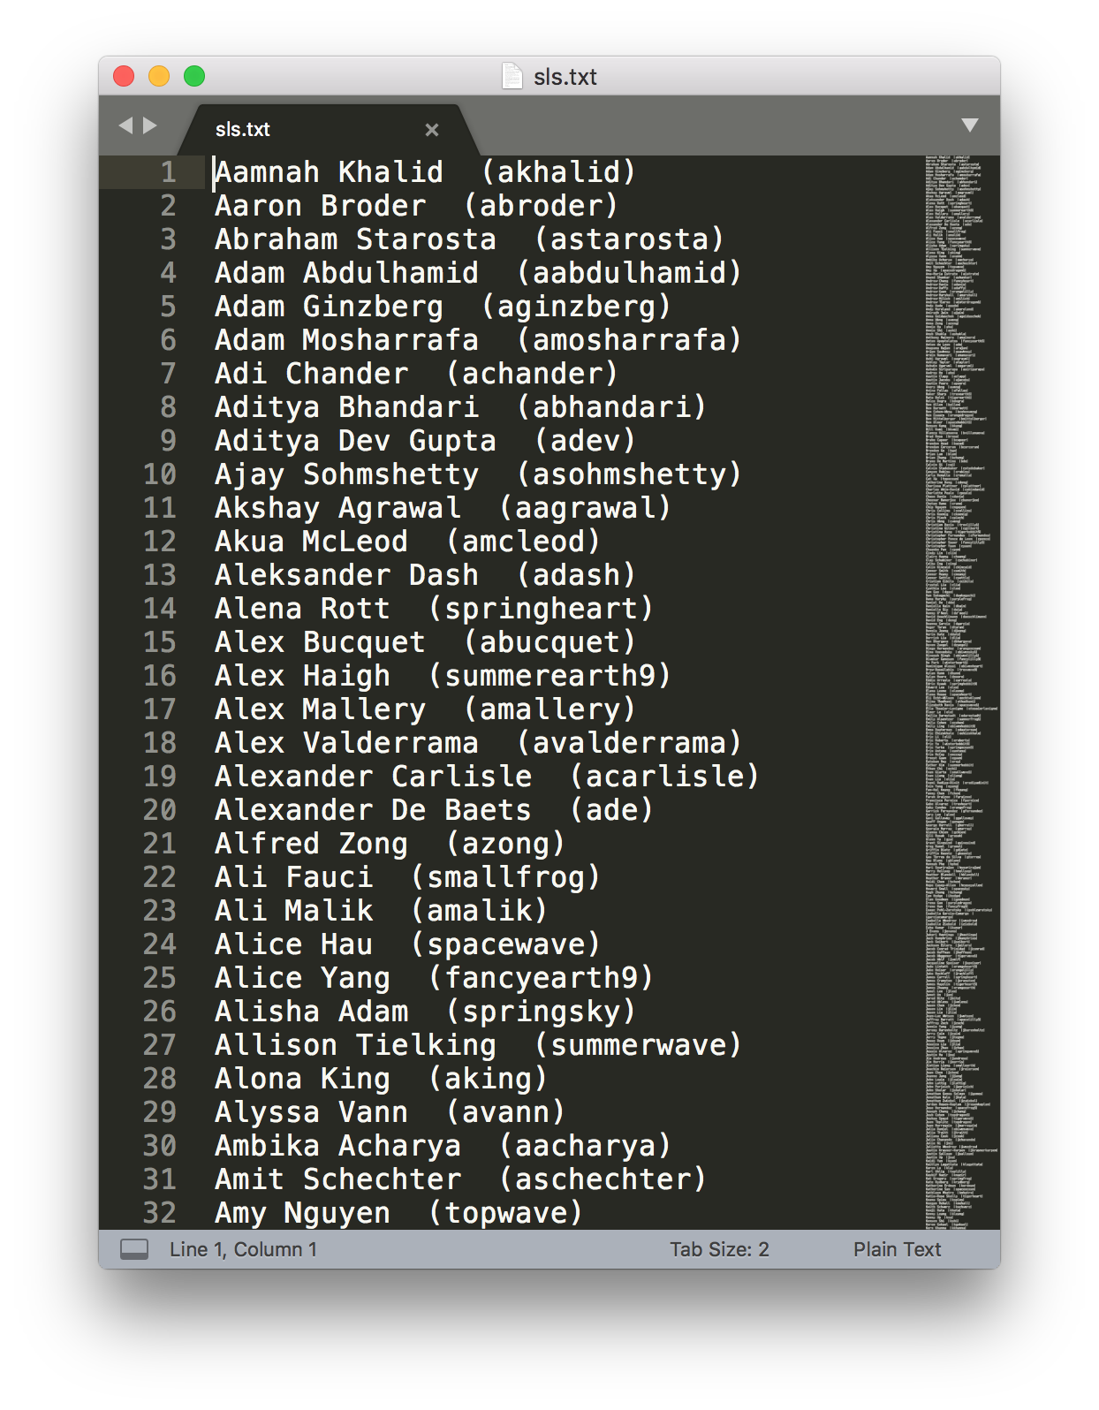
Section Leader Who
sls.txt:
Has all section leaders in
history, one per line.
Example Name:
Alisha Adam (springsky)

Slide 28
Section Leader Who
/* Print Query Responses
* ---------------------
* Print all students who have the query as either
* their sunetId or as one of their names
* Example queries:
* "Chris", "Capoor", "Maya", "mziv"
*/
private void printQueryResponses(String query) {
// TODO: your code here
}

Slide 29
Approach #1: Needle in Haystack
Query: "Davis"
Chris
Piech
cpiech
Brahm
Capoor
bcapoor
Maya
Ziv
mziv
Laura
Cruz-Albrecht
gcandes
Andrew
Tierno
atierno
Christian
Davis
cdavis

Slide 30
Approach #1: Needle in Haystack
Query: "Davis"
Chris
Piech
cpiech
Brahm
Capoor
bcapoor
Maya
Ziv
mziv
Laura
Cruz-Albrecht
gcandes
Andrew
Tierno
atierno
Christian
Davis
cdavis

Slide 31
Approach #1: Needle in Haystack
Query: "Davis"
Chris
Piech
cpiech
Brahm
Capoor
bcapoor
Maya
Ziv
mziv
Laura
Cruz-Albrecht
gcandes
Andrew
Tierno
atierno
Christian
Davis
cdavis

Slide 32
Approach #1: Needle in Haystack
Query: "Davis"
Chris
Piech
cpiech
Brahm
Capoor
bcapoor
Maya
Ziv
mziv
Laura
Cruz-Albrecht
gcandes
Andrew
Tierno
atierno
Christian
Davis
cdavis

Slide 33
Approach #1: Needle in Haystack
Query: "Davis"
Chris
Piech
cpiech
Brahm
Capoor
bcapoor
Maya
Ziv
mziv
Laura
Cruz-Albrecht
gcandes
Andrew
Tierno
atierno
Christian
Davis
cdavis

Slide 34
Approach #1: Needle in Haystack
Query: "Davis"
Chris
Piech
cpiech
Brahm
Capoor
bcapoor
Maya
Ziv
mziv
Laura
Cruz-Albrecht
gcandes
Andrew
Tierno
atierno
Christian
Davis
cdavis

Slide 35
Approach #1: Needle in Haystack
Query: "Davis"
Chris
Piech
cpiech
Brahm
Capoor
bcapoor
Maya
Ziv
mziv
Laura
Cruz-Albrecht
gcandes
Andrew
Tierno
atierno
Christian
Davis
cdavis

Slide 36

Too Slow!

Slide 37
You design the solution
First, lets get our feet wet

Slide 38
Parse File Lines
index
0
1
2
3
…
12
…
17
18
"Alisha Adam (aadam)"
line.substring(13, 18);
line.substring(0, 12);

Slide 39
Section Leader Who
/* Print Query Responses
* ---------------------
* Print all students who have the query as either
* their sunetId or as one of their names
* Example queries:
* "Chris", "Capoor", "Maya", "mziv"
*/
private void printQueryResponses(String query) {
// TODO: your code here
}

Slide 40
Key
Value
piech
cpiech
chris
wang
…
["Chris Piech (cpiech)”]
["Chris Piech (cpiech)”]
[
"Chris Collins (ccollins)"
"Chris Koenig (ckoenig)"
"Chris Piech (cpiech)"
"Chris Wang (cwang)
]
Database HashMap
Approach #2: HashMap
[
"Anna Wang (awang)",
"Avery Wang (awang)",
"Chris Wang (cwang)",
"Lisa Wang (lwang)”,
…

Slide 41
Key
Value
Database HashMap
How do we build
the hashmap?
Approach #2: HashMap

Slide 42
Key
Value
Database HashMap
Originally no
“chris”
key…
Approach #2: HashMap

Slide 43
Key
Value
Database HashMap
Approach #2: HashMap
When we see the first “Chris”

Slide 44
Key
Value
chris
[
"Chris Collins (ccollins)”
]
Database HashMap
Approach #2: HashMap
When we see the first “Chris”

Slide 45
Key
Value
chris
[
"Chris Collins (ccollins)"
"Chris Koenig (ckoenig)”
]
Database HashMap
Approach #2: HashMap
When we see the second “Chris”

Slide 46
Key
Value
chris
[
"Chris Collins (ccollins)"
"Chris Koenig (ckoenig)"
"Chris Piech (cpiech)”
]
Database HashMap
Approach #2: HashMap
When we see the thrid “Chris”

Slide 47
Key
Value
chris
[
"Chris Collins (ccollins)"
"Chris Koenig (ckoenig)"
"Chris Piech (cpiech)"
"Chris Wang (cwang)"
]
Database HashMap
Approach #2: HashMap
When we see the fourth “Chris”

Slide 48


Slide 49
Know how to do this
Imagine a String -> String hashmap:
HashMap<String, String> original =
new HashMap<String, String>();

Slide 50
Original
Key
Value
“Brahm”
“Dog”
“Maya”
“Cat”
“Gabby”
“Dog”
“Chris”
“Zebra”

Slide 51
Reversed
Key
Value
“Dog”
[“Brahm”, “Gabby”]
“Cat”
“[Maya]”
“Zebra”
“[Chris]”

Slide 52
Know how to do this
/**
* Reverse Map:
* Perhaps the best hashmap practice...
* Try and work through it before next weeks section
*/
private HashMap<String, ArrayList<String>> reverse(
HashMap<String, String> original) {
// TODO: your code here
return null;
}

Slide 55
What Collection?
Tic Tac Toe board
char[][]

Slide 56
What Collection?
Election Vote Counter
HashMap<String,
Integer>

Slide 57
What Collection?
Wikipedia
HashMap<String,
ArrayList<String>>

Slide 58
What Collection?
3D Brain Scan
double[][][]

Slide 59
What Collection?
Google Images
HashMap<String,
ArrayList<GImage>>

Slide 60
What Collection?
Shazam

Slide 61
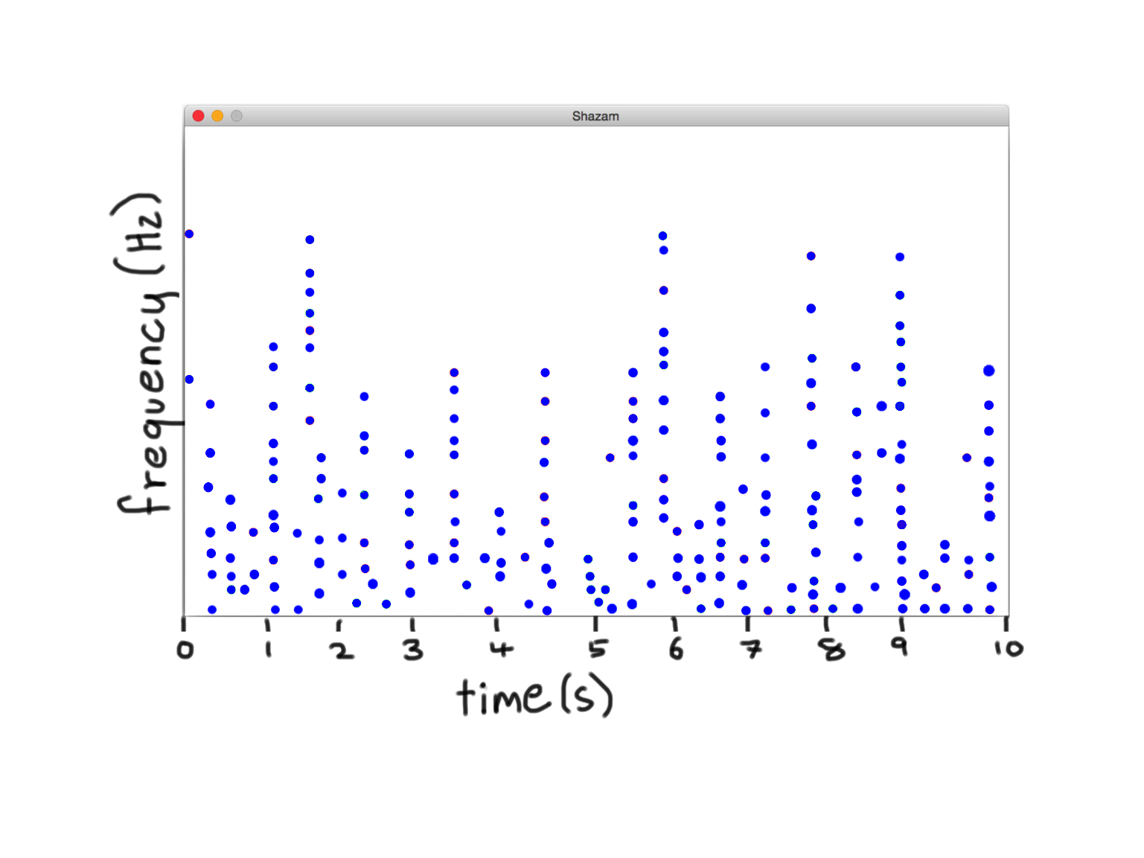

Shazam Query
Wang, A. An Industrial-Strength Audio Search Algorithm

Slide 62
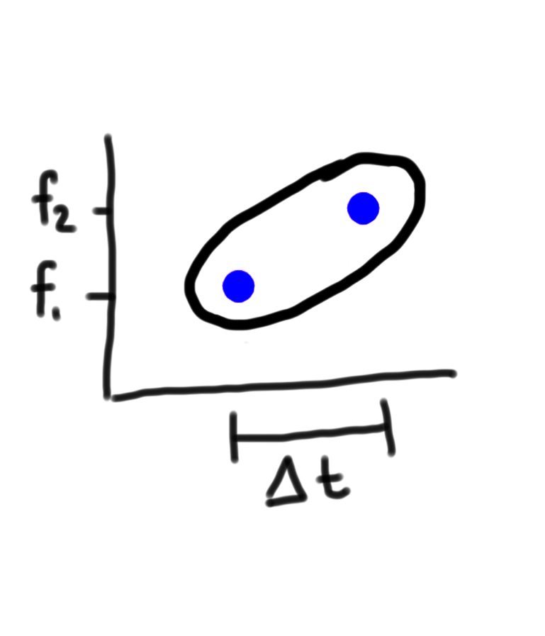
Note Pair
Wang, A. An Industrial-Strength Audio Search Algorithm

Slide 63
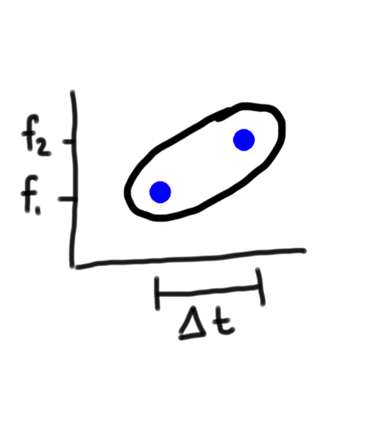
HashMap NotePair -> Song List
Shazam
Key:
Value:
You Can Call Me Al – Paul Simon. 7s,
You Can Call Me Al – Paul Simon. 43s,
All Right Now – Police. 18s
Wang, A. An Industrial-Strength Audio Search Algorithm

Slide 64
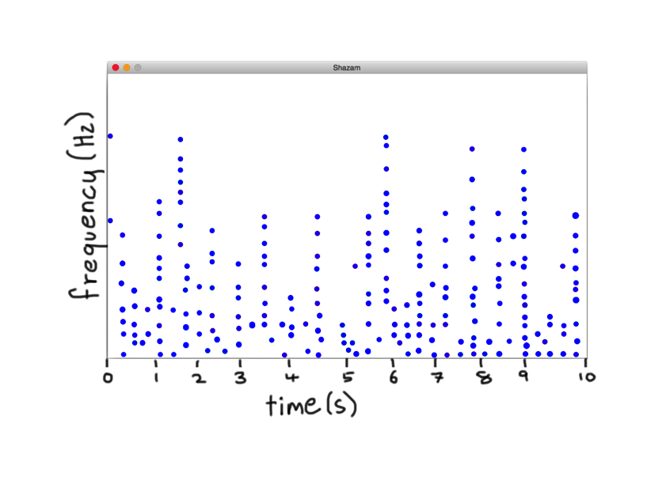
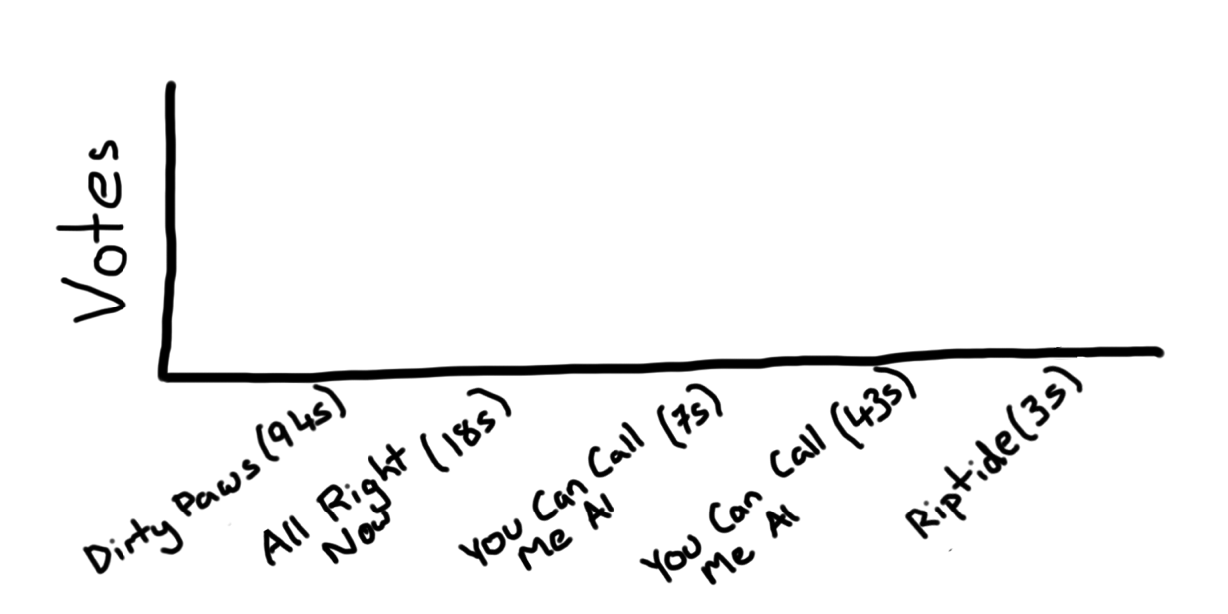
HashMap NotePair -> Song List

Slide 65


HashMap NotePair -> Song List

Slide 66

HashMap NotePair -> Song List

Slide 67
HashMap NotePair -> Song List

Slide 68
HashMap NotePair -> Song List

